Slide 1
Environmental Impacts of Mountaintop Removal in Mud, West Virginia
Presented by Gabriel Guzman
ES 363 – Remote Sensing

Slide 2
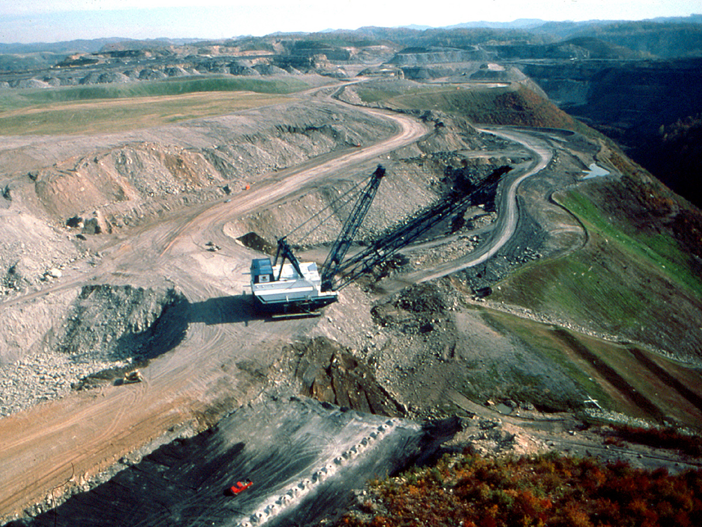
Introduction
What is mountain top removal?
What are the known environmental impacts?
Habitat destruction (Bernhardt & Palmer, 2011)
Site Contamination (Naslund et at, 2020)
Hobet mine in West Virginia, U.S (Murphy, 2019)
Notes:
INTRODUCTION
What is Mountaintop Removal?
Mountaintop removal → Any method of surface coal mining that destroys a mountaintop or ridge line
- Coal mining has been the primary industry in West Virginia since coal was fisrt discovered in 1742
- Mountaintop mining causes deforestation, carbon dioxide emissions, sulfur contamination, biodiversity loss and hydrology changes
What are the known environmental impacts?
The Hobet mine has been more destructive to the surrounding ecosystem thatn any other mine in Appalachia. Damages to the Mud River watershed were great
Habitat destruction (Bernhardt & Palmer, 2011)
- Appalachian forest are recognized as biodiversity hot spot for endemic aquatic salamanders and mussels
- Surface mining is the main land-use change
- 1,1 Million hectares of Appalachian forest has been lost to mountaintop removal mining
- Mining affects sediment and chemical pollutant levels in streams, disturbing aquatic ecosystems
Site Contamination (Naslund et al, 2020)
- Appalachian streams have been contaminated with Selenium among other waterborne contaminants
- These contaminants have great impacts to riparian food webs
- Appalachian streams have highest Selenium concentrations due to mining drainage in the literature
Hobert mine (West Virginia, U.S)
- Hobet property comprises 12,000 acres of land
- Active coal mine from 1972 – 2015 (41 years)
- One of largest surface coal mines in the United States
- Scale of alteration of the landscape destroyed a great amount o biodiversity in the region
- Since the bankruptcy of the mine’s holding company in 2015, the Virginia Conservation Legacy Fund has assumed responsible for the Hobet mine

Slide 3
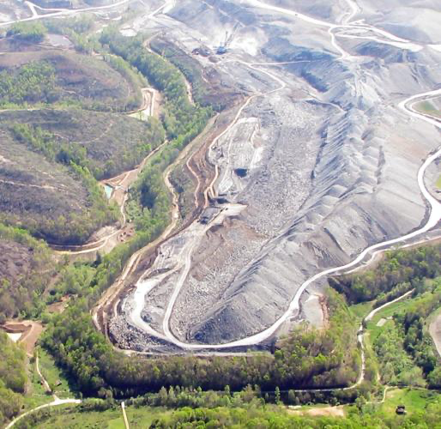
Methods
Google Earth Engine
Two period change analysis (with unsupervised classification)
Start: 1985-01-01 → 2005-12-31
End: 2014-01-01 → 2020-12-31
Notes:
METHODS
Google Earth Engine
- Cloud based platform used to conduct geospatial analysis of the landscape change in the Hobet mine, West Virginia
- Focused on Landsat data, ranging from LS7-LS9 (1984-present)
Two Period Change Analysis (with unsupervised classification)
- Method used in remote sensing and geospatial analysis to examine changes surface changes over two specific periods of time
- Helps monitor

Slide 4
Results
Figures (Study area, unsupervised classification, Two-period change Analysis)
Tables (Confusion Matrix, Classification Percentage Cover)
Notes:
RESULTS

Slide 5
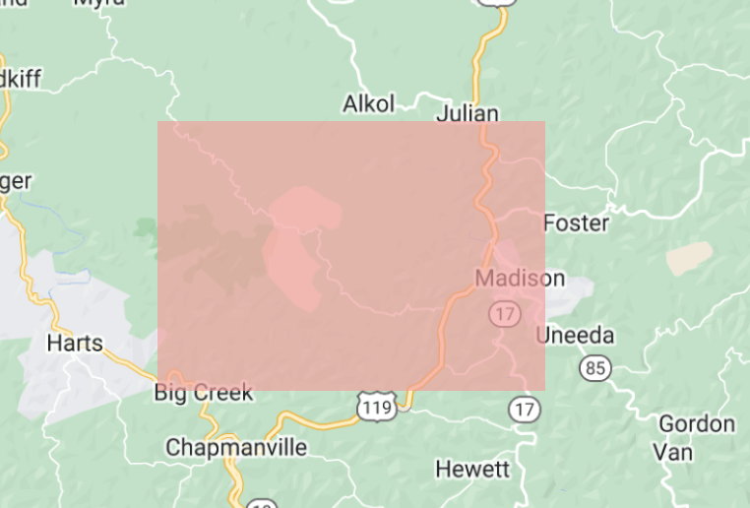
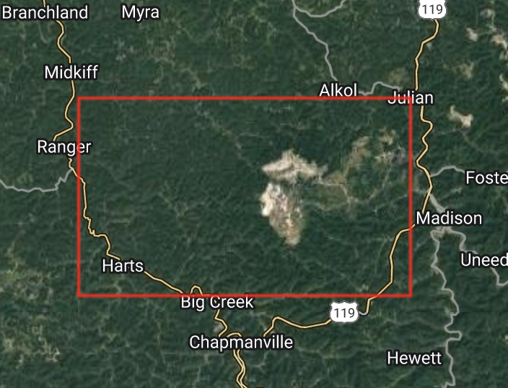
Figures
Image 1: Study Area (Map)
Image 2: Study Area (Satellite)
Notes:
FIGURES
https://code.earthengine.google.com/3247a09db0c9a132303227274b480da1

Slide 6
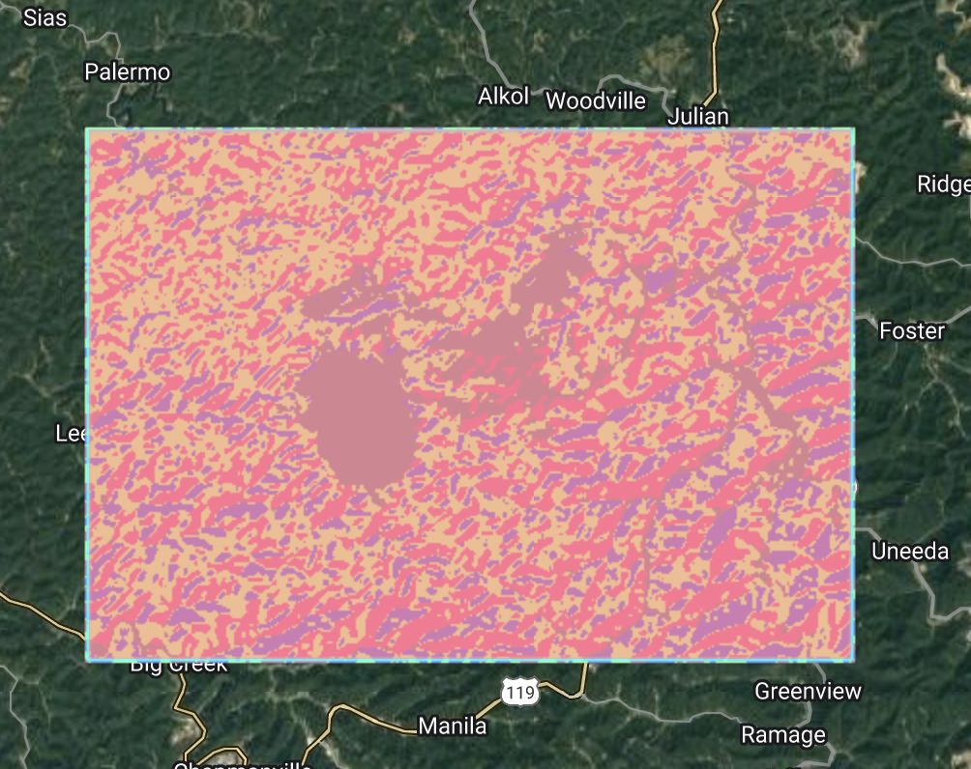
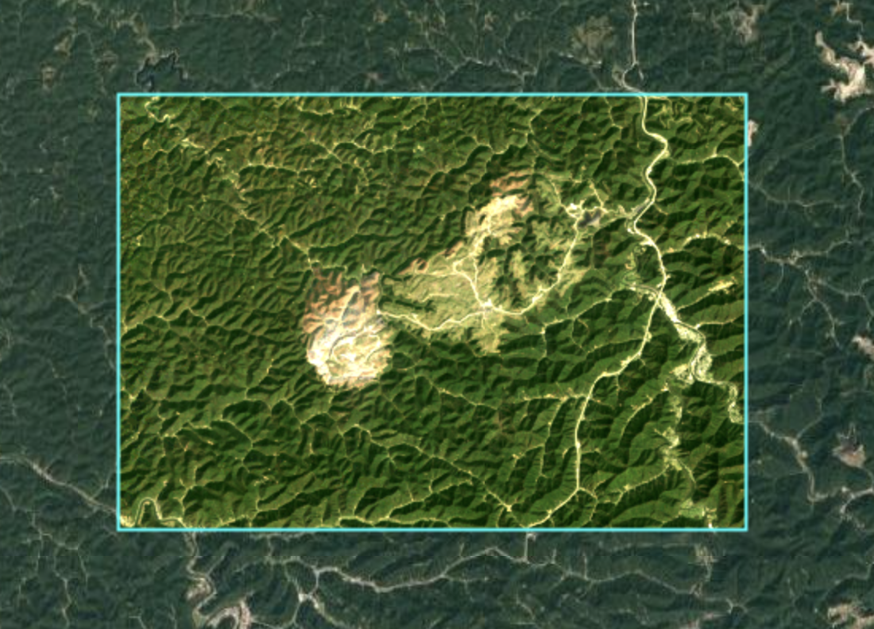
Figures
Image 2: Unsupervised Classification
Image 3: Two-period Change Analysis
Notes:
FIGURES
https://code.earthengine.google.com/3247a09db0c9a132303227274b480da1

Slide 7
Table: Unsupervised Classification
Class | Area Cover (Percentage)
Forest (Class 100) | 79.67 %
Roads (Class 101) | 2.13%
Mine Class (102) | 18.2%
Notes:
TABLE
https://code.earthengine.google.com/3247a09db0c9a132303227274b480da1

Slide 8
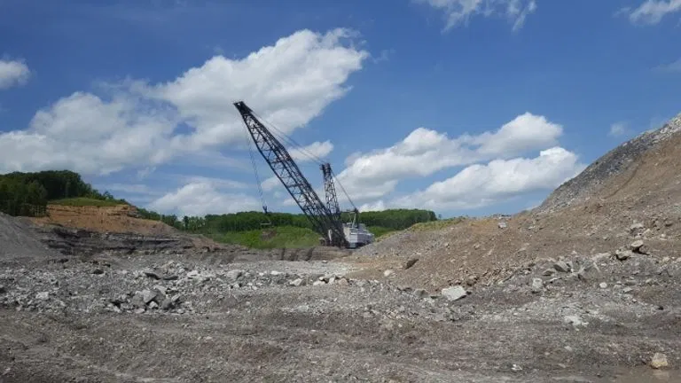
Discussion
Redevelopment efforts (Morris, 2016)
Environmental restoration of former mines
Notes:
DISCUSSION
Redevelopment Efforts (Morris, 2016)
- In 2016, the West Virginia state Division of Highways started bids for the design and construction of an access road to the Hobet mine site, in order to allow for its redevelopment
- The Hobet mine site has been mapped in order to proceed with redevelopment efforts
- Local landowners support redevelopment
- Local, state and federal funds are being requested to pursue redevelopment
Environmental Restoration of Former Mines
- Tree planting is currently being done by the Virginia Conservation Legacy Fund
- Stream restoration can be done to undo damage (Bernhadt and Palmer 2011)

Slide 9
Thanks!
Do you have any questions?

Slide 10
Works Cited
Bernhardt, E. S., & Palmer, M. A. (2011). The environmental costs of mountaintop mining valley fill operations for aquatic ecosystems of the Central Appalachians. Annals of the New York Academy of Sciences, 1223(1), 39–57. https://doi.org/10.1111/j.1749-6632.2011.05986.x
Contaminant Subsidies to Riparian Food Webs in Appalachian Streams Impacted by Mountaintop Removal Coal Mining. (2020). Retrieved December 7, 2023, from Environmental Science & Technology website: https://pubs.acs.org/doi/full/10.1021/acs.est.9b05907
Morris, J. (2016, May 12). West Virginia officials announce progress on Hobet mine site redevelopment efforts. Retrieved December 7, 2023, from WCHS website: https://wchstv.com/news/local/west-virginia-officials-announce-progress-on-hobet-mine-site-redevelopment-efforts
Murphy, B. (2019). Hobet Mine Mountaintop Removal. Retrieved December 7, 2023, from Digital Commons @ Cal Poly Humboldt website: https://digitalcommons.humboldt.edu/hjsr/vol1/iss41/17/
‌

